Slide 1



2022 -2023
Thakur polytechnic
Electronics and telecommunication engineering
Digital Techniques
(DTE-22320)
Topic:-
NAND and NOR using AND OR NOT
01
02
04
06
Samarth Dabholkar (46)
RAVI GUPTA
SHIVAM YADAV
vikas sharma
(47)
(53)
(57)

Slide 2

Universal Gates:
2022 -2023
A universal gate is a gate which can implement any Boolean function without need to use any other gate type.
The NAND and NOR gates are universal gates.
In practice, this is advantageous since NAND and NOR gates are economical and easier to fabricate and are the basic gates used in all IC digital logic families.
In fact, an AND gate is typically implemented as a NAND gate followed by an inverter not the other way around!!
Likewise, an OR gate is typically implemented as a NOR gate followed by an inverter not the other way around!!

Slide 3










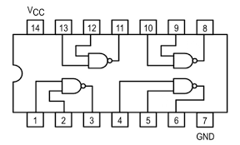
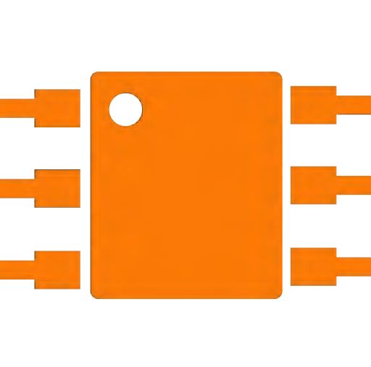
2022 -2023
NAND
boolean expression
logical operators
Y = A.B
NOT AND
(7400)

Slide 4









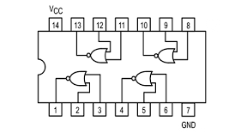
2022 -2023
NOR
boolean expression
logical operators
Y = A+B
NOT , OR
(7402)

Slide 5

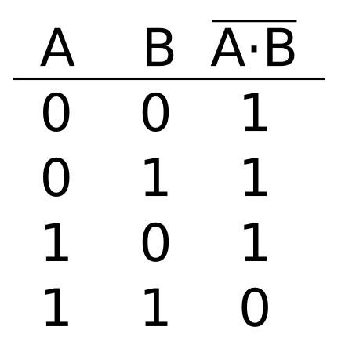
NAND Gate:
2022 -2023
01
The NAND gate represents the complement of the AND operation. Its name is an abbreviation of NOT AND.
The graphic symbol for the NAND gate consists of an AND symbol with a bubble on the output, denoting that a complement operation is performed on the output of the AND gate.
The truth table and the graphic symbol of NAND gate is shown in the figure.
Y = A.B
The truth table clearly shows that the NAND operation is the complement of the AND.

Slide 6

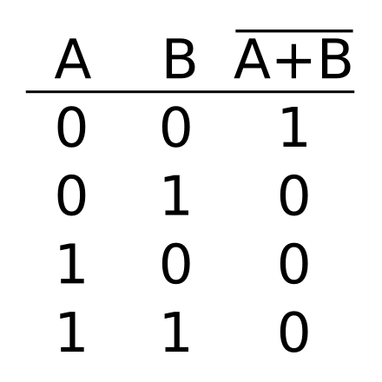

02
2022 -2023
NOR Gate:
The NOR gate represents the complement of the OR operation. Its name is an abbreviation of NOT OR.
The graphic symbol for the NOR gate consists of an OR symbol with a bubble on the output, denoting that a complement operation is performed on the output of the OR gate.
The truth table and the graphic symbol of NOR gate is shown in the figure.
Y = A+B
The truth table clearly shows that the NOR operation is the complement of the OR.

Slide 7

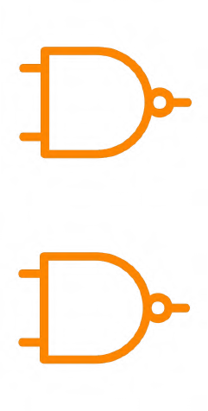

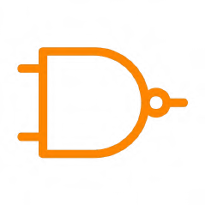
NAND Gate is a Universal Gate:
2022 -2023
To prove that any Boolean function can be implemented using only NAND gates, we will show that the AND, OR, and NOT operations can be performed using only these gates.
AN OR GATE CAN BE REPLACED BY NAND GATES AS SHOWN IN THE FIGURE
( THE OR GATE IS REPLACED BY A NAND GATE WITH ALL ITS INPUTS COMPLEMENTED BY NAND GATE INVERTERS).
A'
A
A
(A'B') = A+B
A + B
B
B'
B
Thus, the NAND gate is a universal gate since it can implement the AND, OR and NOT functions.

Slide 8


NOR Gate is a Universal Gate:
2022 -2023
To prove that any Boolean function can be implemented using only NOR gates, we will show that the AND, OR, and NOT operations can be performed using only these gates.
AN OR GATE CAN BE REPLACED BY NOR GATES AS SHOWN IN THE FIGURE ( THE OR IS REPLACED BY A NOR GATE WITH ITS OUTPUT COMPLEMENTED BY A NOR GATE INVERTER)
A
(A+B)'
A+B
A
A + B
B
B
Thus, the NOR gate is a universal gate since it can implement the AND, OR and NOT functions

Slide 9
Thank you!
2022 -2023

